Slide 1
Mars-blog
By Cael Milne (51875017), Dimitri Dinis (51876736)

Slide 2
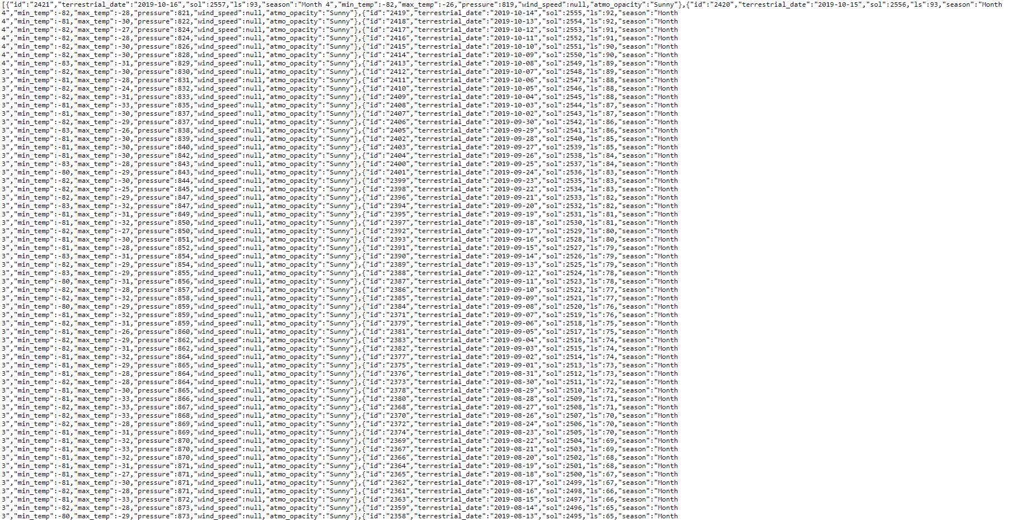
Open Data Source
https://pudding.cool/2017/12/mars-data/marsWeather.json
Mars weather data starting from 2014
Stores Date, Solstice, Minimum Temperature, Maximum Temperature, Pressure
We focussed on the Minimum and Maximum Temperatures

Slide 3
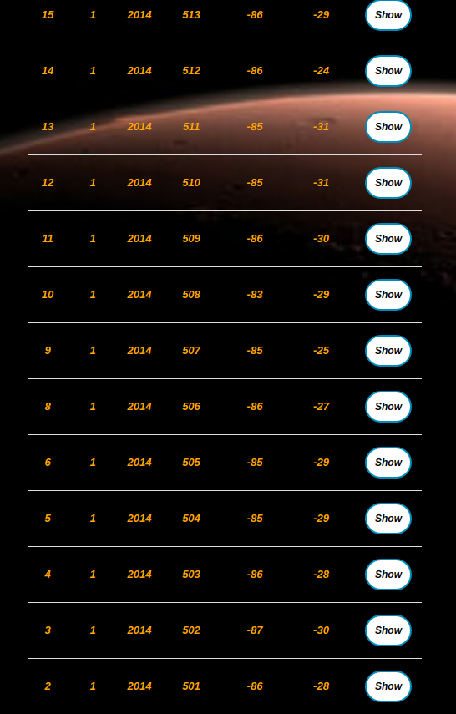
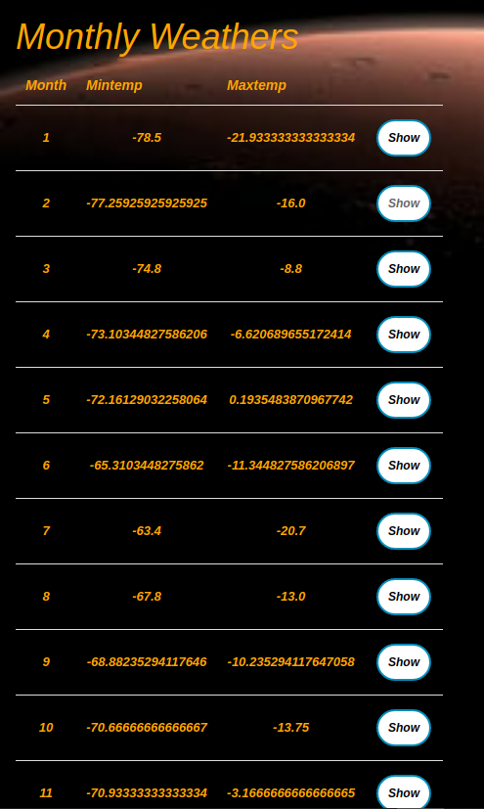
Open data storage and usage
Weathers Table
Average Temperatures for each Month➔
Open Data source Converted to CSV
Rake task, reads data from Weathers table and finds average Minimum and Maximum Temperature for each month of the year (2018)
Raked into Active Record Database

Slide 4
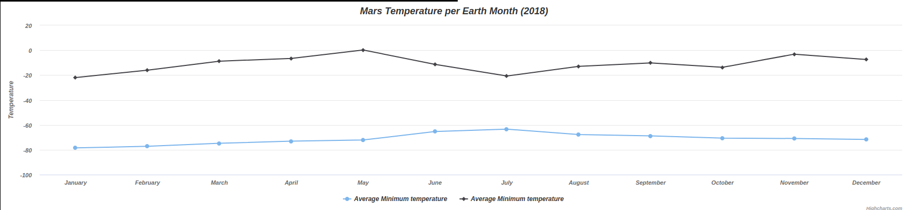
Open data graph
Uses 2018 average Temperatures to create graph.
Highcharts Line Graph

Slide 5
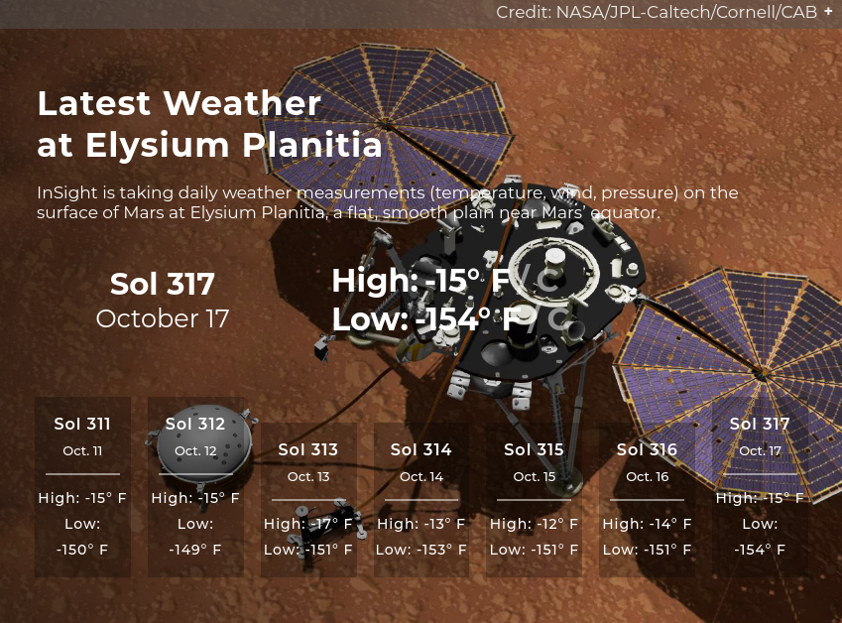
Live nasa data api
Weather data from most recent update
Shows weather data from the last 7 days

Slide 6
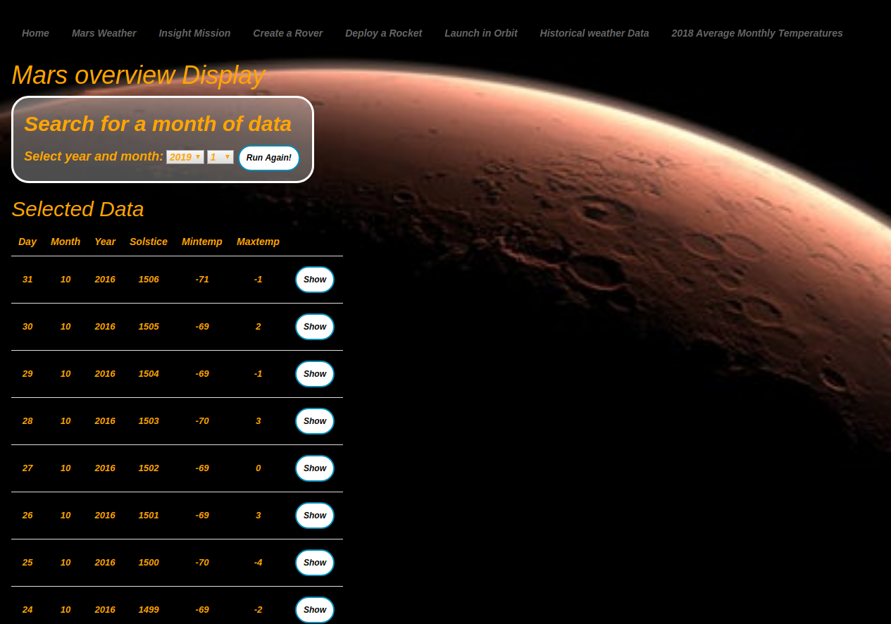
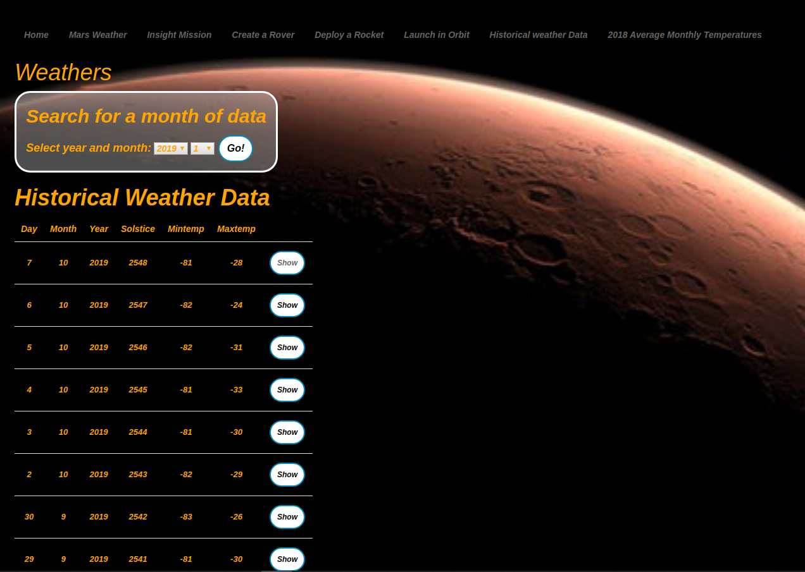
Search function
Form leads to results page
Search through Historic Weather data for a specific year and month
Search function can be re-run

Slide 7
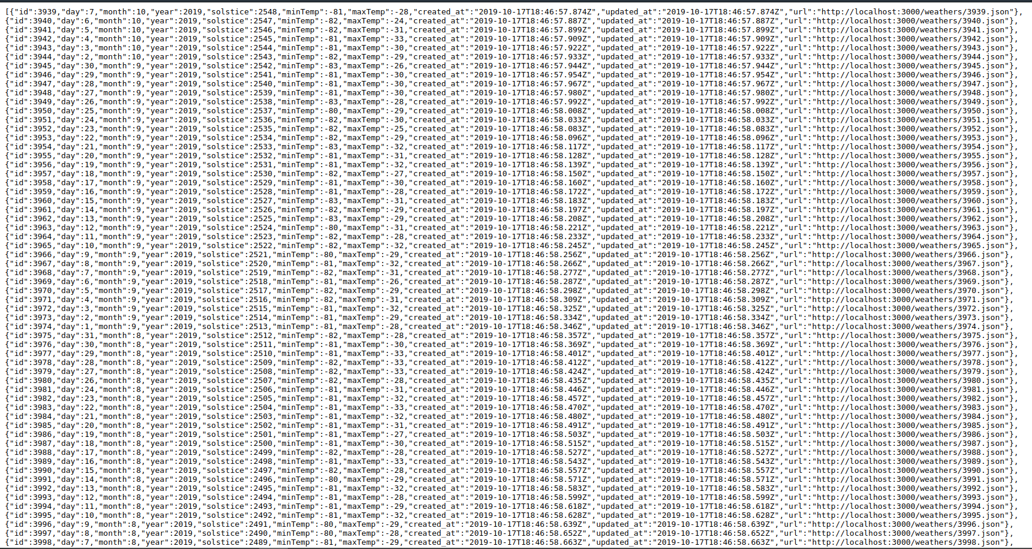
Json
Json output is available for all the tables in our web app
Weathers (Full data-set)
Monthly Weather (2018 monthly averages)
Engines (User Populated Table)
Rovers (User Populated Table)(Linked to Engines Table)
Orbits (User Populated Table)
Whole Database tabled returned in Json format (index page)
Single record returned in Json format (show page)

Slide 8
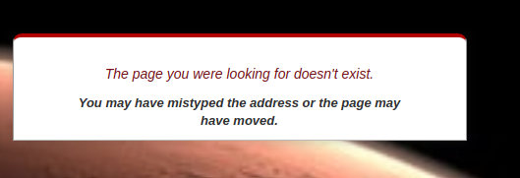
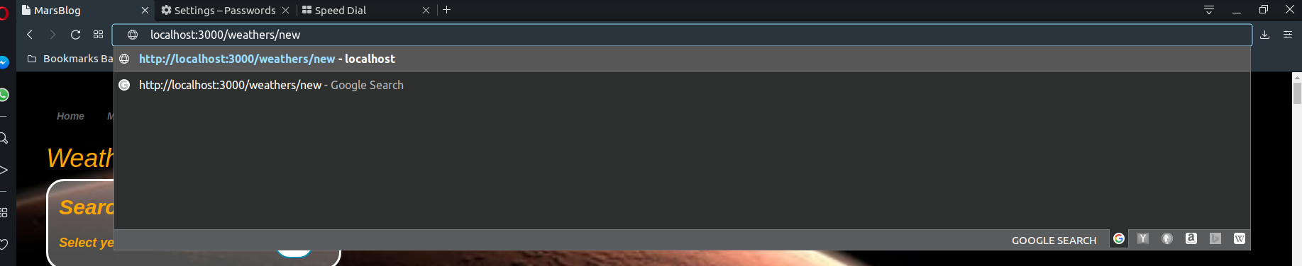
Removed routes/ invalid routes
Rails scaffold function automatically creates some routes/functions for each record in the table
Show
Edit
Delete
We removed the Edit and Delete functions from our historic weather Data-set and average monthly weather table.
Any invalid URL entered leads to a page with this prompt in the middle of the screen
Leads to
This required a rescue statement to be added to the controller, which redirected to the invalid URL page

Slide 9
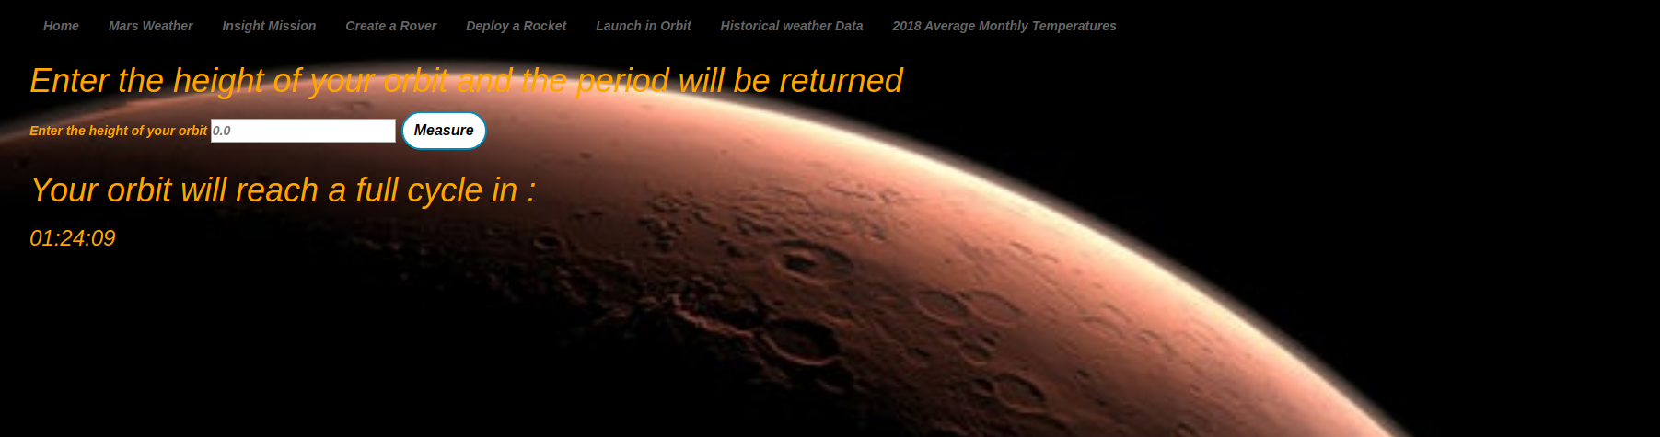
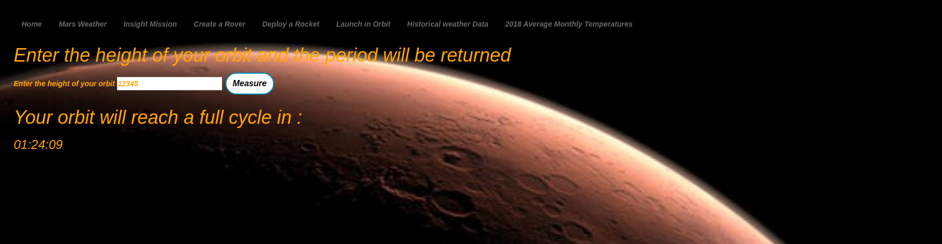

Periods measurements
Default placeholder = 0.0
Pre form submission
Post form submission

Slide 10
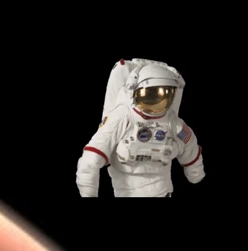
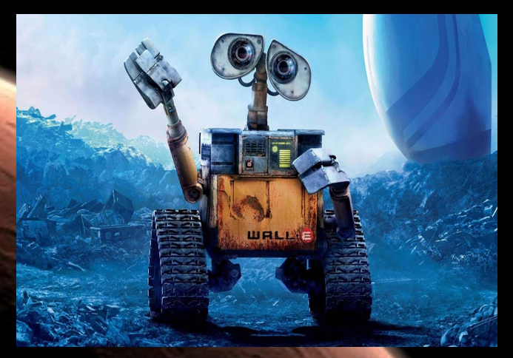
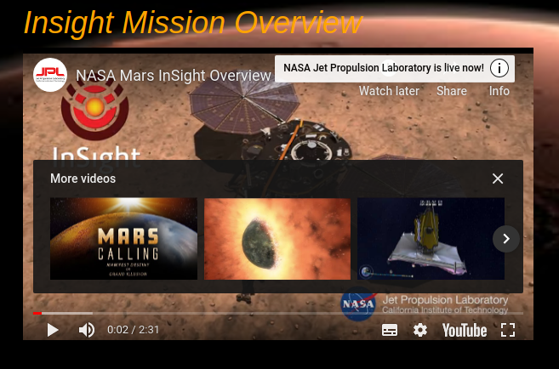
extras
Dancing Spaceman Gif
YouTube video
Everyone’s favourite Robot (Wall-E)

